Slide 1

JOB MARKET ANALYSIS DASHBOARD
Data Science Job Market Analysis Using Power BI | SQL | Excel
Presented By
N Lokesh

Slide 2
Business Problem
The job market contains a large number of Data Science-related job postings across different companies, industries, and locations.
Job seekers need insights into salary trends, hiring demand, required skills, and educational qualifications to make informed career decisions.
Companies need to understand market trends, skill requirements, and hiring competition to attract qualified talent.
Manual analysis of hundreds of job postings is time-consuming and inefficient.
An interactive Job Market Analysis Dashboard is required to identify hiring trends, salary patterns, skill demand, and education requirements for data-driven decision-making.

Slide 3
Dataset Overview
Total Job Posting Records: Approximately 739
Data Source: Data Science Job Market Database
Key Columns Used:
Job Title, Company Name, Industry, Location, Salary Estimate, Degree, Rating, Python, SQL, Excel, AWS, Spark, Tableau and other skill-related fields.
Purpose:
To analysis job market trends, salary patterns, hiring demand, required skills, educational qualifications, and company hiring activities in the Data Science domain.

Slide 4
Data Cleaning Process
Connected to the Job Market database and imported the dataset.
Standardized column names for consistency and readability.
Checked for missing values and handled null or invalid records where necessary.
Verified salary-related fields and skill columns for accurate analysis.
Validated data quality and prepared the dataset for visualization and reporting.

Slide 5
Job Market Analysis Dashboard
Dashboard Highlights
States with the highest number of Data Science job opportunities were identified.
Average salary variations across different states were analysed.
Top 5 industries with the highest number of Data Science job postings were identified.
Companies with the maximum number of job openings were analysed.
The dashboard provides a comprehensive overview of hiring trends and salary patterns in the Data Science job market.

Slide 6
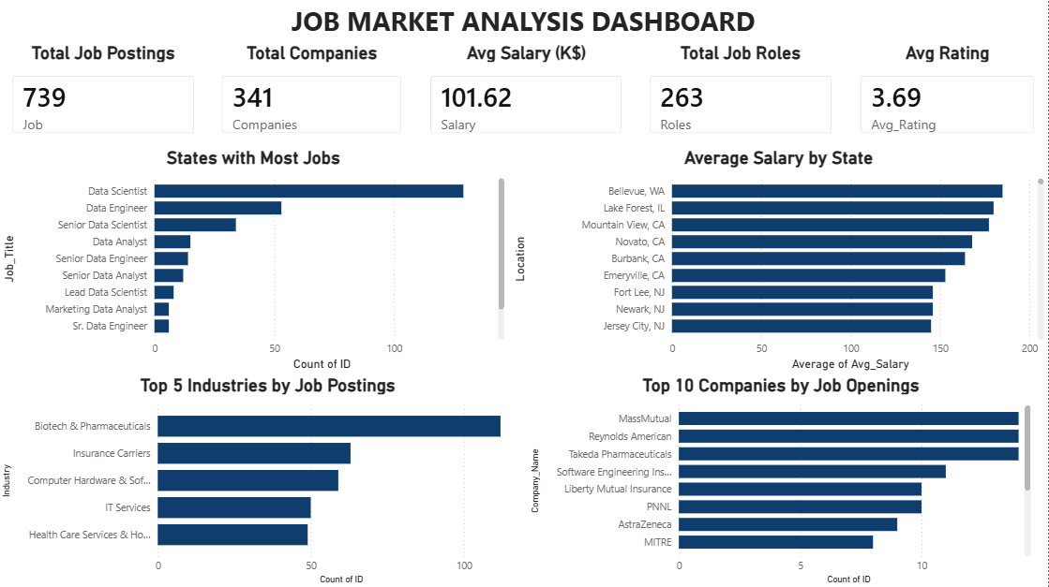

Slide 7
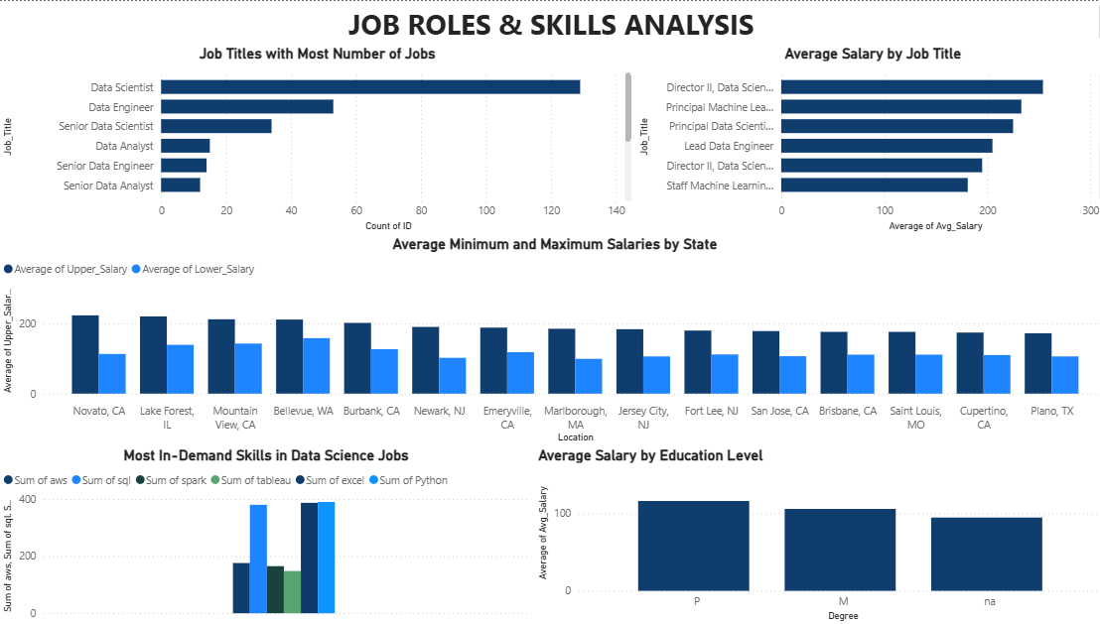

Slide 8
Dashboard Highlights
Job Market Analysis Dashboard:
States with the highest number of Data Science job opportunities were identified.
Average salary variations across different states were analysed.
Top 5 industries with the highest number of Data Science job postings were identified.
Companies with the maximum number of job openings were analysed.
The dashboard provides a comprehensive overview of hiring trends and salary patterns in the Data Science job market.
Job Roles & Skills Analysis Dashboard:
Job titles with the highest number of openings were identified.
Average salary comparison across different job roles was analysed.
Most in-demand technical skills required by employers were identified.
The relationship between educational qualifications and average salary was evaluated.
The dashboard provides insights into job demand, salary trends, and skill requirements in the Data Science job market.

Slide 9
Key Business Insights
Data Scientist and Data Engineer are among the most in-demand job roles in the Data Science job market.
Salary levels vary significantly across different states, indicating regional differences in hiring demand and compensation.
Biotech & Pharmaceuticals and other technology-driven industries have a high number of Data Science job postings.
Python, SQL, and other technical skills are among the most frequently requested skills by employers.
A small number of companies contribute a significant share of total job openings.
Educational qualifications have an impact on salary levels, with higher qualifications generally associated with better compensation opportunities.

Slide 10
Recommendations
Job seekers should focus on developing Python, SQL, and other in-demand technical skills to improve employability.
Organizations should invest in employee upskilling and continuous learning programs to meet evolving industry demands.
Companies should focus recruitment efforts on locations with strong Data Science talent availability.
Candidates seeking higher compensation should target industries and job roles that consistently offer competitive salaries.
Pursuing higher educational qualifications can improve career growth opportunities and earning potential in the Data Science field.

Slide 11
Conclusion
The Job Market Analysis Dashboard successfully analyzed Data Science job postings, salary trends, hiring demand, required skills, and educational qualifications.
The dashboard provided valuable insights into job opportunities across different states, industries, and companies.
The analysis identified the most demanded job roles, key technical skills, and salary patterns in the Data Science job market.
These insights can help job seekers make informed career decisions and assist organizations in developing effective hiring and workforce strategies.

Slide 12
Thank You..!

